Slide 1





ADOBE DEVCRAFT
REAL TIME BIDDING SYSTEM
TEAM : ACCESS DENIED
Samay Jain ( Leader)
Ibrahim Haneef
Mohd Hassan
Hemant Singh
Delhi Technological University

Slide 2




Idea & Approach – Real-Time Bidding (RTB) System
Core Idea & Objective
We propose the development of an intelligent bidding optimization system for Demand-Side Platforms (DSPs) in Real-Time Bidding (RTB). Our solution ensures optimal bid placement, budget efficiency, and maximized advertiser outcomes by leveraging predictive modeling and AI-driven bidding strategies.
Key Highlights
AI-driven bid decision-making for smarter ad placements.
Market price estimation prevents overbidding and maximizes ROI.
01
Data Processing & Feature Engineering
We process large-scale bid logs using chunked loading (100K rows/batch) for memory efficiency. Features include user behavior, ad slot characteristics, and time-based trends. Historical bidding patterns enhance market insights.
Real-time execution with bid response time under 5ms.
Dynamic budget pacing optimizes spend distribution over time.
02
Predictive Modeling for Bidding
Our CTR model (AUC 0.8803) predicts click probability, while the CVR model (AUC 0.8516) estimates conversions. A market price estimator helps optimize bid amounts, reducing overspending. It is only on training on 1 day data
03
Budget Optimization Strategy
We implement adaptive bid pacing to prevent early budget depletion. Priority-based bidding aligns ad spend with business goals, ensuring high-value conversions get preference.
04
Real-Time Bidding Engine Implementation
A LightGBM-powered decision engine ensures bid responses under 5ms, balancing speed and accuracy for seamless real-time auctions

Slide 3
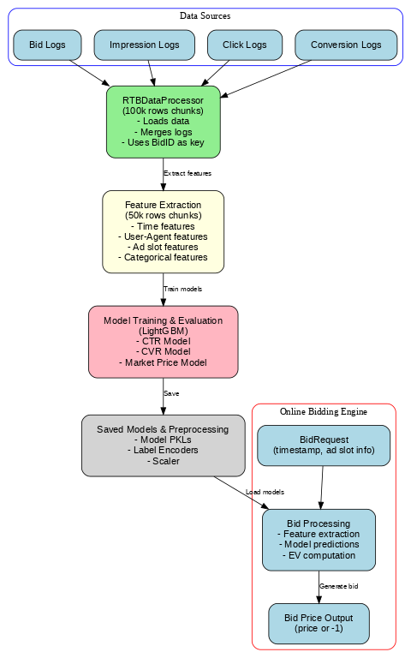
Flow Diagram

Slide 4
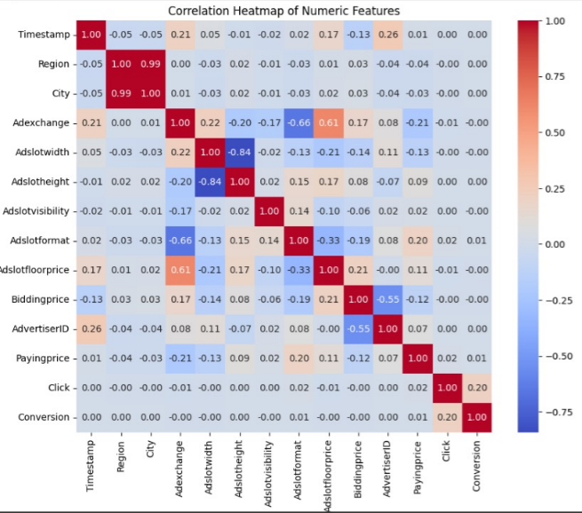
Exploratory Data Analysis
HeatMap of Co-relations

Slide 5
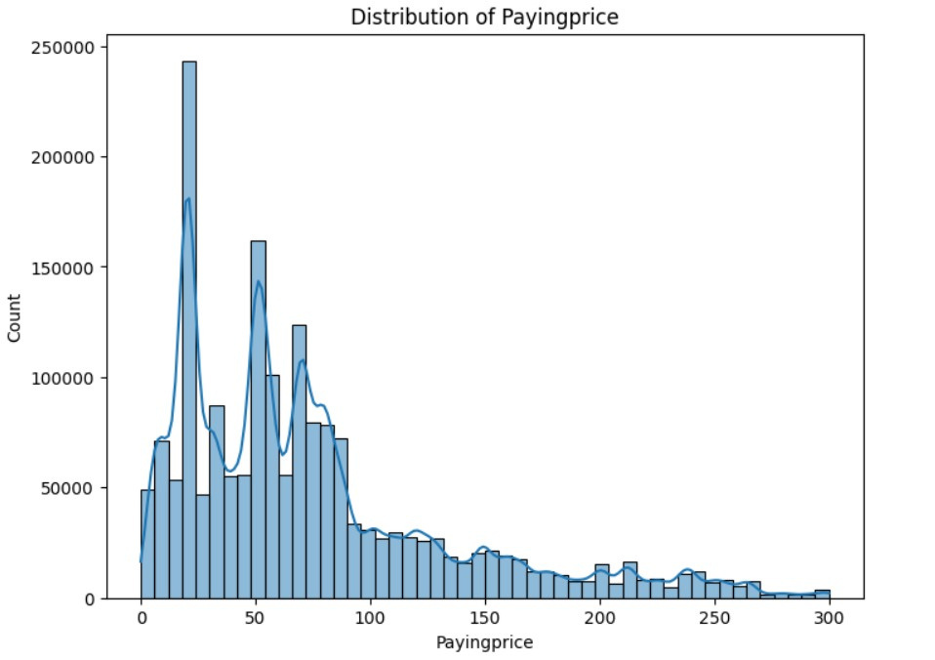
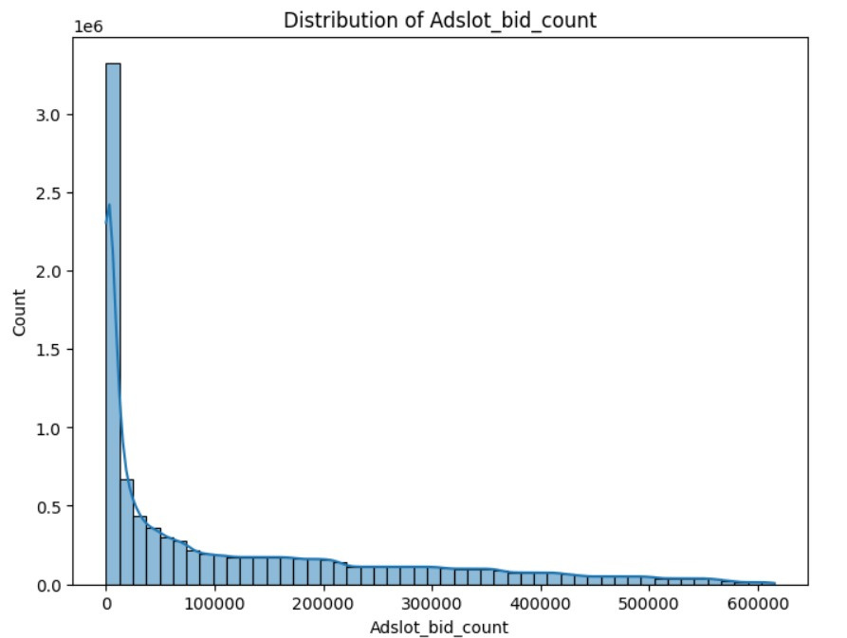
Exploratory Data Analysis
Histograms for Paying Price and Adslot Bid count

Slide 6
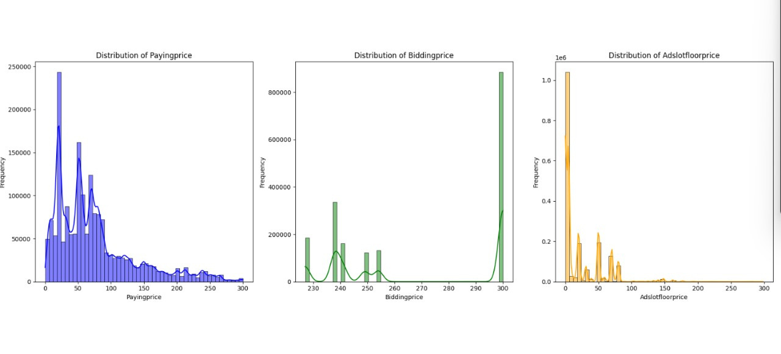
Exploratory Data Analysis
Line-Charts for PayingPrice, BiddingPrice and AdSlotFloorPrice

Slide 7
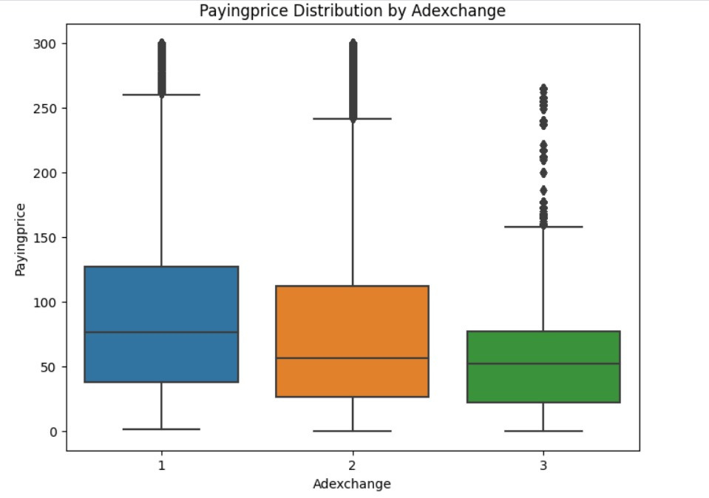
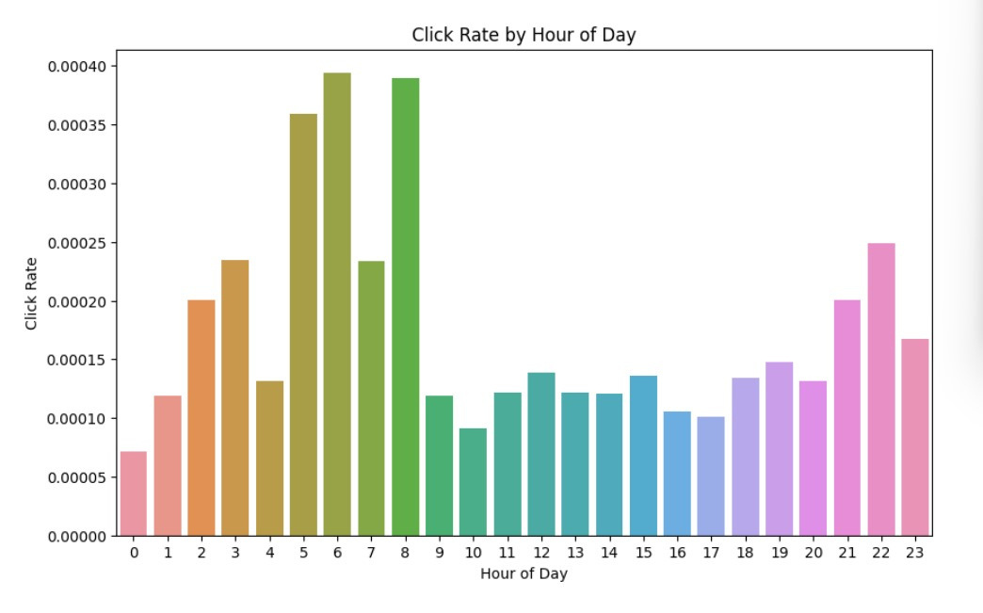
Exploratory Data Analysis
Box-Plot for Paying Price grouped by AdExchange
Bar-Char of Click Rate based on Timestamp

Slide 8
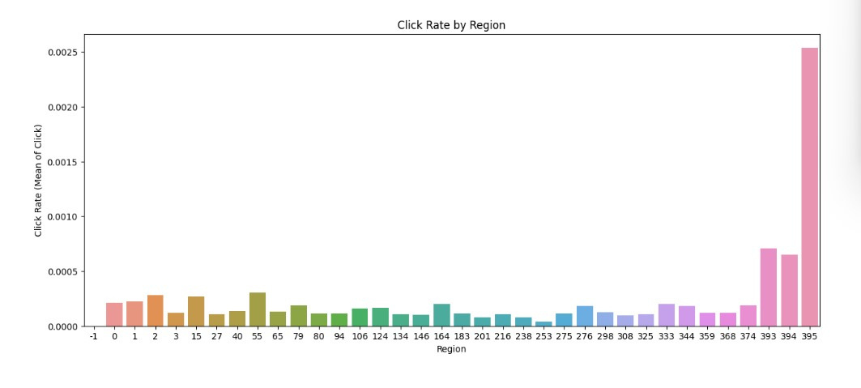
Exploratory Data Analysis
Bar-Chart for Region vs Click Rate

Slide 9
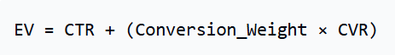
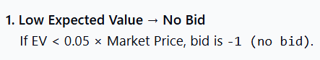
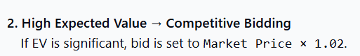
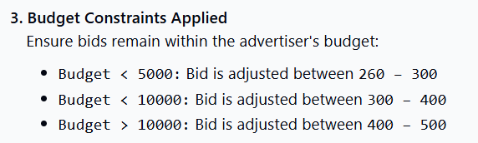
Bidding Strategy
Expected Value (EV) Calculation
Bid Price Decision Rules
Optimizations For Constraints
✅ Parallel Processing: Setting n_jobs=-1 enables
multi-core processing
✅ Numba JIT (Just-In-Time) Optimization: Speeds
up numeric feature scaling

Slide 10
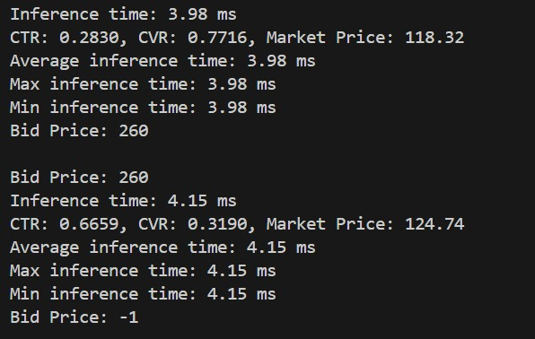
Results & Inference Time

Slide 11








Tech Stack
Pandas
Load, Process, Merge
NumPy
Process Numeric Arrays
LGBM
Predict Bid Outcomes
SKlearn
Preprocess, Split, Evaluate
Faster Numerical Calcualtion
Numba

Slide 12
Future scope
Model Optimization
Dynamic Budget Pacing
Feature Enrichment and Scalability Testing
Currently only limited data has been used due to time and resource constraints. Further training on the entire dataset will help in considerably increasing AUC and improving model reliability.
Develop a more sophisticated mechanism to adjust bids based on remaining budget and real-time performance.
Integrate additional contextual features or real-time user behavior signals.
Stress-test the bidding engine under simulated high-load conditions.

Slide 13
Thank
You

